Slide 1
PRO2000 - programming
Week 44- Parallel programming
Gebremariam Assres
Gebremariam.assres@kristiania.no
[Adapted from QwertyPi (Daniel Hsieh)]

Slide 2
Today's topics
Why parallel programming?
Processes and threads
Parallel processing
Race condition
Mutual exclusion (mutex)
Synchronization methods
Design principles

Slide 3

Why parallel programming?
Parallel Programming in C++
3
How to speed up processing?
Increase hardware clock rate
Issue: heat dissipation
● => Run in parallel
Source: Wikipedia

Slide 4
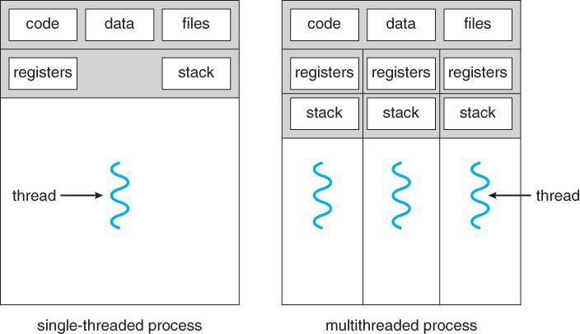
Processes and threads
Parallel Programming in C++
4
A process is an independent program running in memory, while a thread is a smaller unit of execution inside that process.
Threads are shared memory:
  Shared (common to all threads in the process): global variables (bss), heap memory, and program code.
  Isolated (private to each thread): registers, program counter, and local (stack) variables.
  We focus on multi-threading today
Notes:
In C++ memory layout, .bss (Block Started by Symbol) is the memory segment that stores uninitialized or zero-initialized global and static variables.
In a multithreaded C++ application, the .bss segment is critically important because it is completely shared among all threads within the process.
While each thread gets its own private, isolated stack to handle local variables and function calls, they all look at the exact same virtual address space for .bss (as well as the .data, .text, and heap segments).

Slide 5


Parallel processing
Parallel Programming in C++
6
Example: Sum of Array in Parallel
  This problem is parallel: so, we can split it into several unrelated tasks easily
  Target: Compute the sum of n = 10⁸ integers
long long global_sum = 0; mutex sum_mutex;
void compute_sum(vector<int>& a, int start, int end) { long long sum = 0;
for (int i = start; i < end; i++) sum += a[i]; lock_guard<mutex> lock(sum_mutex);
global_sum += sum;
}
int num_threads = 4; vector<thread> threads;
int chunk_size = (n + num_threads - 1) / num_threads; for (int t = 0; t < num_threads; t++) {
int start = t * chunk_size;
int end = min(start + chunk_size, n); threads.emplace_back(compute_sum, ref(a), start, end);
}
for (auto& th : threads) { th.join();
}
long long global_sum = 0;
for (int i = 0; i < n; i++) { global_sum += a[i];
}
3.95x

Slide 6
Parallel processing …
Parallel Programming in C++
7
Example: Sum of Array in Parallel …
long long global_sum = 0; mutex sum_mutex;
void compute_sum(vector<int>& a, int start, int end) { long long sum = 0;
for (int i = start; i < end; i++) sum += a[i];
2. “Locks” the global sum
lock_guard<mutex> lock(sum_mutex); global_sum += sum;
}
int num_threads = 4; vector<thread> threads;
int chunk_size = (n + num_threads - 1) / num_threads; for (int t = 0; t < num_threads; t++) {
int start = t * chunk_size;
int end = min(start + chunk_size, n);
1. Constructs and spawns the thread
threads.emplace_back(compute_sum, ref(a), start, end);
}
for (auto& th : threads) { th.join();
3. Waits for the thread to end and join
}

Slide 7

Race condition
7
Parallel Programming in C++
8
Parallel Programming in C++
Example: Sum of Array in Parallel - Data Race
long long global_sum = 0; //mutex sum_mutex;
void compute_sum(vector<int>& a, int start, int end) { //long long sum = 0;
for (int i = start; i < end; i++) sum += a[i];
What if no lock, and we directly add to global_sum?
//lock_guard<mutex>lock(sum_mutex); //global_sum += sum;
}
int num_threads = 4; vector<thread> threads;
int chunk_size = (n + num_threads - 1) / num_threads; for (int t = 0; t < num_threads; t++) {
int start = t * chunk_size;
int end = min(start + chunk_size, n);
The sum is smaller than expected... Also, it is (comparatively) super slow
Exemplar of data races
threads.emplace_back(compute_sum, ref(a), start, end);
}
for (auto& th : threads) { th.join();
}

Slide 8
Race condition …
9
BSS global_cnt = 0;
Thread 1 int N = 100000; for (int i = 0; i < N; i++) { global_cnt++; } |  | Thread 2 int N = 100000; for (int i = 0; i < N; i++) { global_cnt++; }
Expect: 200000
Actual: 117963
Why?
Incrementing global_cnt++ translates to three non atomic operation is (using registers as in the assembly code below):
mov eax, [global_cnt] ; eax := global_cnt
inc eax ; eax := eax + 1
mov [global_cnt], eax ; global_cnt := eax

Slide 9
Race condition …
Parallel Programming in C++ 15
BSS global_cnt = 1;
Thread 1
eax := global_cnt // eax: 0
Thread 2
Context switch
Context switch
eax := global_cnt // eax: 0
eax := eax + 1 // eax: 1
Context switch
Registers are not shared!
eax := eax + 1 global_cnt := eax
// eax: 1
Context switch
global_cnt := eax

Slide 10
Race condition …
Parallel Programming in C++ 16
BSS global_cnt = 1;
Thread 1 |  | Thread 2
eax := global_cnt // eax: 0
 |  | eax := global_cnt // eax: 0
eax := eax + 1 // eax: 1
 |  | eax := eax + 1 // eax: 1
 |  | global_cnt := eax
global_cnt := eax
An instruction interleaving where global_cnt has a ﬁnal value of 1!

Slide 11
Race condition …
Parallel Programming in C++ 17
Data races occur when two threads:
  Access the same non-atomic memory location simultaneously.
  At least one of the accesses is a write.
  There is no synchronization between the two threads.
In C++, data races will lead to undeﬁned behaviour.

Slide 12
Mutual exclusion
Parallel Programming in C++ 18
Mutual Exclusion: Failed Attempt
  We have to avoid both threads simultaneously accessing global_cnt.
  What about adding another variable?
if (!in_use) { in_use = true; global_cnt++; in_use = false;
}

Slide 13
Mutual exclusion …
Parallel Programming in C++ 21
Mutual Exclusion: Failed Attempt
BSS in_use = false;
global_cnt = 0;
Thread 1
if (!in_use)
Thread 2
// TRUE
Context switch
if (!in_use) // TRUE
in_use = true; global_cnt++; in_use = false;
in_use = true; global_cnt++; in_use = false;

Slide 14
Mutual exclusion …
Parallel Programming in C++ 22
Mutual Exclusion in C++
  Threads should not access the same memory at the same time
  Hence called Mutual Exclusion (mutext)
  C++ mutex: lock() and unlock()
  Once one thread locks the mutex, the other waits for it to unlock, avoiding data race
mutex cnt_mutex; int N = 100000;
for (int i = 0; i < N; i++) { cnt_mutex.lock(); global_cnt++; cnt_mutex.unlock();
}
// global_cnt = 200000

Slide 15
Mutual exclusion …
Parallel Programming in C++ 25
Mutual Exclusion in C++
BSS cnt_mutex: Locked;
Thread 1
cnt_mutex.lock();
global_cnt = 0;
Thread 2
Context switch
Mutex is already locked
⇒ The thread blocks.
cnt_mutex.lock();

Slide 16
Mutual exclusion …
Parallel Programming in C++ 26
Mutual Exclusion in C++
BSS cnt_mutex: Unlocked;
global_cnt = 1;
Thread 1
cnt_mutex.lock();
Thread 2
Context switch
cnt_mutex.lock();
global_cnt++; cnt_mutex.unlock();

Slide 17
Mutual exclusion …
Parallel Programming in C++ 27
Mutual Exclusion in C++
BSS cnt_mutex: Locked;
global_cnt = 1;
Thread 1
cnt_mutex.lock();
Thread 2
The thread wakes up and locks the mutex!
cnt_mutex.lock();
global_cnt++; cnt_mutex.unlock();

Slide 18
Mutual exclusion …
Parallel Programming in C++ 28
Mutual Exclusion in C++
BSS cnt_mutex: Unlocked;
global_cnt = 2;
Thread 1
cnt_mutex.lock();
Thread 2
cnt_mutex.lock();
global_cnt++; cnt_mutex.unlock();
global_cnt++; cnt_mutex.unlock();

Slide 19
RAII (Resource Acquisition Is Initialisation)
Parallel Programming in C++ 29
Synchronization methods
long long global_sum = 0; mutex sum_mutex;
void compute_sum(vector<int>& a, int start, int end) { long long sum = 0;
for (int i = start; i < end; i++) sum += a[i]; lock_guard<mutex> lock(sum_mutex);
global_sum += sum;
}
int num_threads = 4; vector<thread> threads;
int chunk_size = (n + num_threads - 1) / num_threads; for (int t = 0; t < num_threads; t++) {
int start = t * chunk_size;
int end = min(start + chunk_size, n); threads.emplace_back(compute_sum, ref(a), start, end);
}
for (auto& th : threads) { th.join();
}
Questions:
Why constructor spawns thread?
Why don’t we need to “unlock”?
Ties resources to object lifetime
Constructor: acquire resources
Destructor: release resources
C++ does RAII by default for automatic storage (stack)
No need manually manage memory that much anymore!
Notes:
Resource Acquisition Is Initialization (RAII) is a core C++ programming idiom that binds the life cycle of a resource (such as heap memory, a file handle, a network socket, or a mutex lock) to the lifetime of an object.
How RAII Works:
Acquisition in Constructor: You acquire the resource inside the class constructor when the object is instantiated.
Release in Destructor: You release or clean up the resource inside the class destructor.
Automatic Cleanup: When the object goes out of scope, its destructor runs automatically and frees the resource. This happens even if an exception is thrown during stack unwinding.
Examples in C++:
Smart Pointers: std::unique_ptr and std::shared_ptr manage dynamic heap memory automatically.
Locks: std::lock_guard acquires a mutex upon creation and automatically unlocks it when it goes out of scope.
File Streams: std::ifstream and std::ofstream open a file upon construction and close it upon destruction.

Slide 20
Parallel Programming in C++ 30
Synchronization methods …
Mutual Exclusion in C++ with RAII
  Manually handling lock is not good
  You may forget to unlock
  Unlock is needed even when exception raised
  With RAII: lock_guard<mutex>
  Unlock itself once goes out of scope
mutex cnt_mutex; int N = 100000;
for (int i = 0; i < N; i++) {
// cnt_mutex.lock(); lock_guard<mutex>
lock(cnt_mutex); global_cnt++;
// cnt_mutex.unlock();
}

Slide 21
Parallel Programming in C++ 31
Synchronization methods …
Decrease count if success
Semaphores
  Extension of mutex (C++20)
  Allows at most N concurrent connections
  Example: Queue for parking space, wait to enter a store
counting_semaphore<size_t> sem(5); if (sem.try_acquire()) {
// critical section sem.release();
}
  Increase count

Slide 22
Parallel Programming in C++ 32
Synchronization methods …
Barriers
  Sometimes you want ﬁrst complete all of step 1, then step 2
  Barrier: wait for threads to ﬁnish, then starts again
// spawn threads for step 1
for (int t = 0; t < num_threads; t++) { threads.emplace_back(step_1, t);
}
// barrier: wait for all threads to complete for (auto& th : threads) {
th.join();
}
// then continue step 2
for (int t = 0; t < num_threads; t++) { threads.emplace_back(step_2, t);
}
for (auto& th : threads) { th.join();
}

Slide 23
Parallel Programming in C++ 33
Synchronization methods …
Atomic operations
  You can declare stuff as “atomic” (C++11)
  Operations are done as an entirety
  Won’t mess up even if multi-threaded
  Example: maintain counter in multi-threaded program
atomic<int> acnt;
void increment_counter() {
for (int n = 10000; n; --n) {
++acnt;
}
}

Slide 24
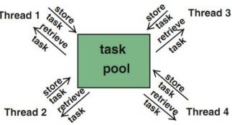
Design principles
Parallel Programming in C++ 38
How to design parallel algorithms?
  Instantiate a "pool of tasks"
  Once a thread is done with it's job, it takes another job.
  So, task distribution goes on like this …

Slide 25
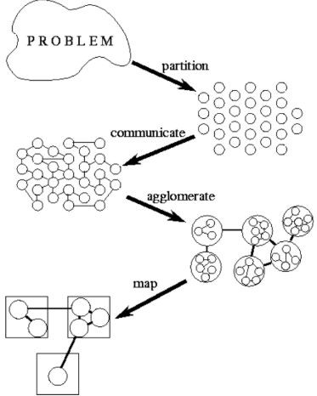
Design principles …
Parallel Programming in C++ 40
How to design parallel algorithms …
  Partition the problem into small tasks
  Small tasks communicate with each other
  Agglomerate tasks to groups to reduce communication cost
  Map tasks to processors (cores)

Slide 26
Up next: Exercises
Now: 2 hours (12:15 to 14:00) of exercises (found on Canvas).
Short exercise summary:
  Write, compile, and debug a C++ programs with emphasis on parallel programing
Remember:
  You should do approximately 4 more hours of the course (in a study group or alone) before our next session together. :-)

